Slide 1

Intel Unnati Industrial Training Program 2024
Project Title: Intel Products Sentiment Analysis from Online Reviews
Aarupadai Veedu Institute Of Technology, Chennai
Name: Aditya Narayan Garg
Reg No: 3502110504
Notes:
1

Slide 2

Problem Statement
Introduction to the Problem:
Intel's Core processors have been reviewed by numerous users and experts.
These reviews are scattered across various platforms such as Amazon, Flipkart, and specialized tech websites.
Challenges:
Manually reading and analyzing all reviews is challenging and time-consuming.
Hence, there is a need to automatically determine if reviews are positive, negative, or neutral.
Goals:
Develop a model to automatically analyze review sentiments.
Identify common themes and issues from the reviews.
Utilize insights to enhance Intel products and marketing strategies.
2
Notes:
SAY: Before we wrap up the course, let’s review what we have learned today.
During this course, we have
<READ the bullets from the slide.>
GO to next slide.

Slide 3
Solution Overview
Data Collection:
Web Scraping: Gathering reviews from platforms like Amazon, Flipkart, and tech websites using web scraping techniques and tools like BeautifulSoup.
Data Preprocessing:
Text Cleaning: Removing HTML tags, special characters, punctuation, and unnecessary whitespace from the extracted reviews.
Tokenization: Splitting the cleaned text into tokens (words or phrases) for further analysis.
Sentiment Analysis:
Sentiment Classification: Training a machine learning model (e.g., Logistic Regression, LSTM) to classify reviews into positive, negative, or neutral sentiments.
Feature Engineering: Using techniques like TF-IDF to represent text data numerically while considering the importance of words in documents.
Model Evaluation and Selection:
Split Data: Dividing the dataset into training and testing sets to train the model and assess its performance using metrics like accuracy, precision, recall, and F1-score.
3
Notes:
SAY: Before we wrap up the course, let’s review what we have learned today.
During this course, we have
<READ the bullets from the slide.>
GO to next slide.

Slide 4

Solution Overview
Insight Generation:
Identify common topics in reviews such as performance, price, and usability to understand what customers care about the most.
Visualization:
Create simple charts or word clouds to visualize the most frequent positive and negative sentiments.
Actionable Insights:
Utilize these insights to enhance Intel's products and marketing strategies based on customer feedback.
Efficient Data Collection: Automate gathering reviews from multiple platforms.
Clear Sentiment Analysis: Develop a straightforward model for categorizing sentiments."

Slide 5
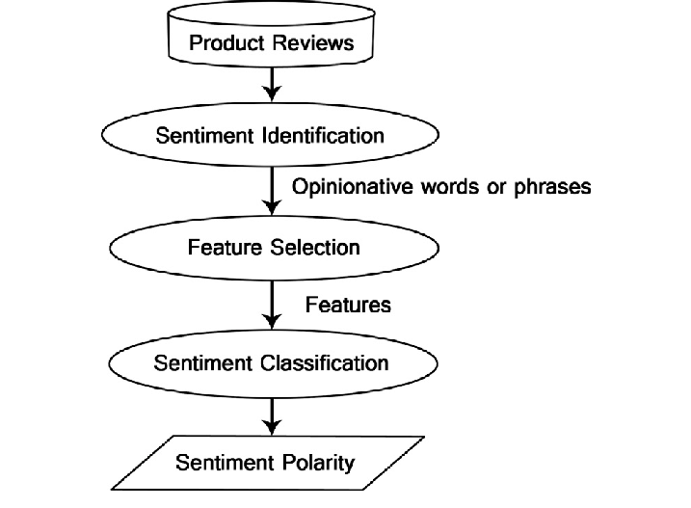
Process Flow
Aggregating reviews from platforms like Amazon, Flipkart, and tech websites.
Clean and preprocess the gathered data to prepare it for analysis.
Apply state-of-the-art NLP algorithms for accurate sentiment analysis.
Feature Extraction
Sentiment Classification
Incorporating analysis results into dashboards and reports.
Use ongoing feedback to refine the model and adapt to evolving customer sentiments.
Continuously improve the sentiment analysis model based on new data and feedback.
●●●
5
Notes:
SAY:
The purpose of epidemiology in public health practice is to
discover the agent, host, and environmental factors that affect health;
determine the relative importance of causes of illness, disability, and death;
identify those segments of the population that have the greatest risk from specific causes of ill health; and
evaluate the effectiveness of health programs and services in improving population health.
GO to next slide.

Slide 6
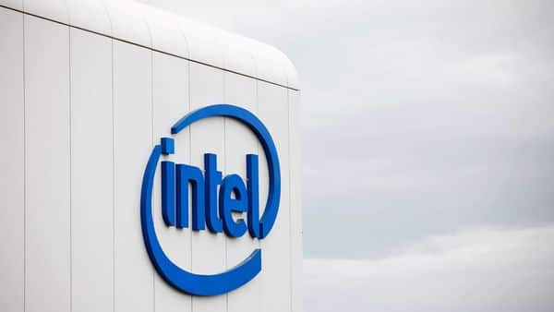
Features Offered
Automatically identifies whether reviews are positive, negative, or neutral.
Identifies specific aspects of Intel products (like performance or price) mentioned in reviews and evaluates sentiment towards each aspect.
Summarizes overall sentiment trends and common themes from reviews to provide actionable insights.
Measures how accurately the sentiment analysis model classifies reviews.
Presents findings visually to facilitate understanding of sentiment patterns and trends.
Guides decisions on product improvements and marketing strategies based on customer feedback insights.
●●●
6
Notes:
SAY:
The purpose of epidemiology in public health practice is to
discover the agent, host, and environmental factors that affect health;
determine the relative importance of causes of illness, disability, and death;
identify those segments of the population that have the greatest risk from specific causes of ill health; and
evaluate the effectiveness of health programs and services in improving population health.
GO to next slide.

Slide 7
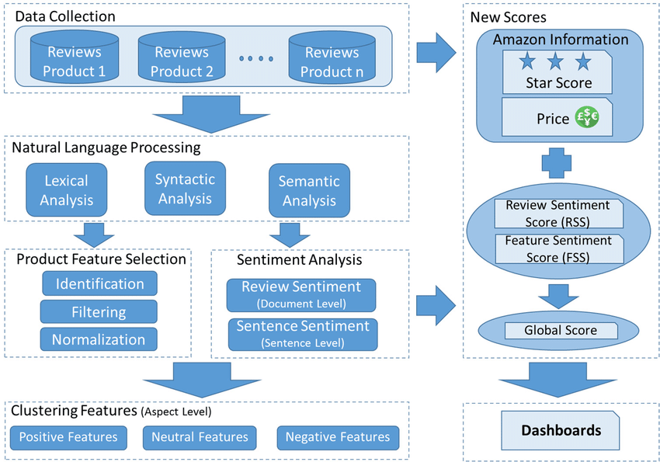
Architectural Diagram
●●●
7
Notes:
SAY:
The purpose of epidemiology in public health practice is to
discover the agent, host, and environmental factors that affect health;
determine the relative importance of causes of illness, disability, and death;
identify those segments of the population that have the greatest risk from specific causes of ill health; and
evaluate the effectiveness of health programs and services in improving population health.
GO to next slide.

Slide 8
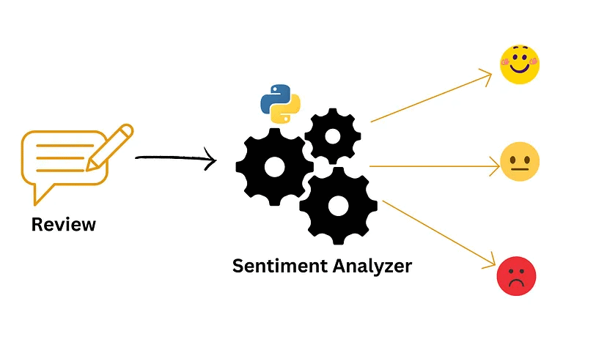
Technology Used
Web Scraping: BeautifulSoup
Data Preprocessing: Python (Pandas, Numpy),
NLP: NLTK, SpaCy
Feature Extraction: Scikit-learn (TF-IDF Vectorizer, Count Vectorizer)
Sentiment Analysis Models: Scikit-learn, TensorFlow, Keras, PyTorch (LSTM, CNN). Keras, PyTorch
Model Evaluation: Scikit-learn (accuracy, precision, recall, F1-score).
Topic Modeling: Gensim
Visualization: Matplotlib, Seaborn, Plotly
Automation and Integration: Python scripts, Jupyter Lab, APIs
●●●
8
Notes:
SAY:
The purpose of epidemiology in public health practice is to
discover the agent, host, and environmental factors that affect health;
determine the relative importance of causes of illness, disability, and death;
identify those segments of the population that have the greatest risk from specific causes of ill health; and
evaluate the effectiveness of health programs and services in improving population health.
GO to next slide.

Slide 9
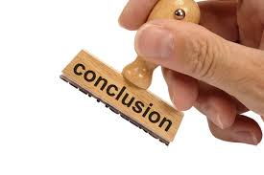
Conclusion
Intel's product review sentiment analysis harnesses advanced technologies to precisely gather, organize, and classify reviews from various platforms. It utilizes machine learning to accurately categorize sentiments and topic modeling to identify key themes. The clear visualizations make insights easy to understand, and continuous feedback ensures the model's ongoing relevance. This robust approach not only empowers Intel to enhance their products and marketing strategies based on customer feedback but also enables them to promptly address common issues and elevate overall customer satisfaction. By continually refining their analysis, Intel maintains a strong competitive edge and drives ongoing innovation in their product offerings.
9
Notes:
SAY:
The purpose of epidemiology in public health practice is to
discover the agent, host, and environmental factors that affect health;
determine the relative importance of causes of illness, disability, and death;
identify those segments of the population that have the greatest risk from specific causes of ill health; and
evaluate the effectiveness of health programs and services in improving population health.
GO to next slide.

Slide 10
10
Notes:
SAY:
The purpose of epidemiology in public health practice is to
discover the agent, host, and environmental factors that affect health;
determine the relative importance of causes of illness, disability, and death;
identify those segments of the population that have the greatest risk from specific causes of ill health; and
evaluate the effectiveness of health programs and services in improving population health.
GO to next slide.

